Slide 1

Input /output statement
Python Programming Training
ConsoleLancer LLP

Slide 2
Data types
Python Programming Training
ConsoleLancer LLP

Slide 3
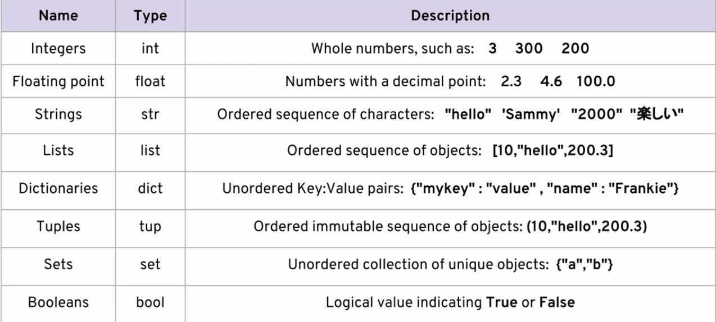
Python Programming Training
ConsoleLancer LLP

Slide 4
Python Programming Training
ConsoleLancer LLP

